Slide 1

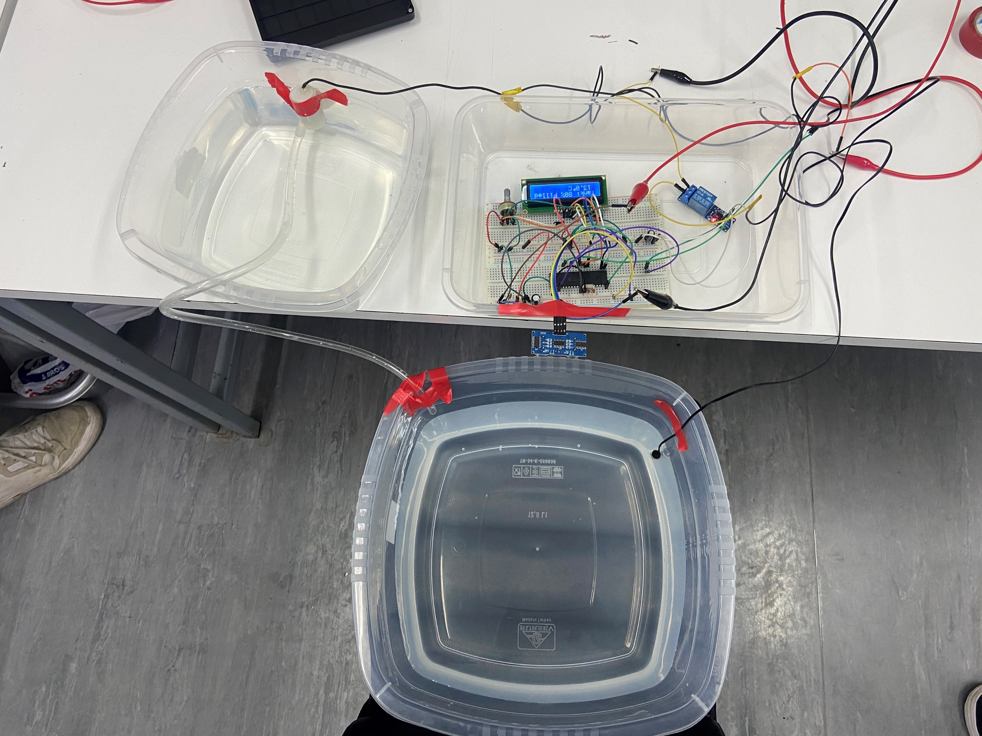
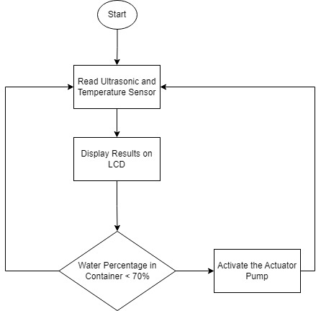
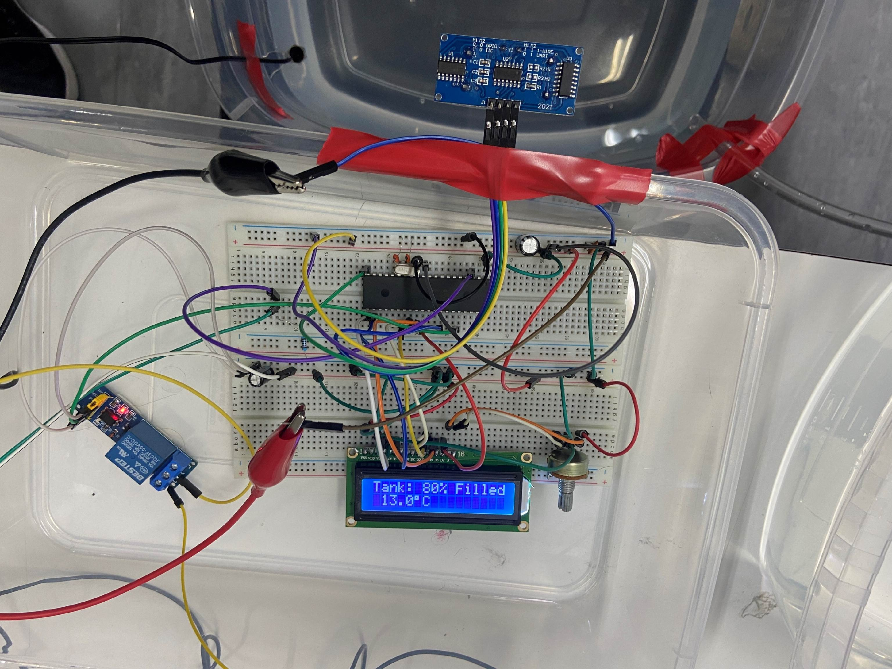
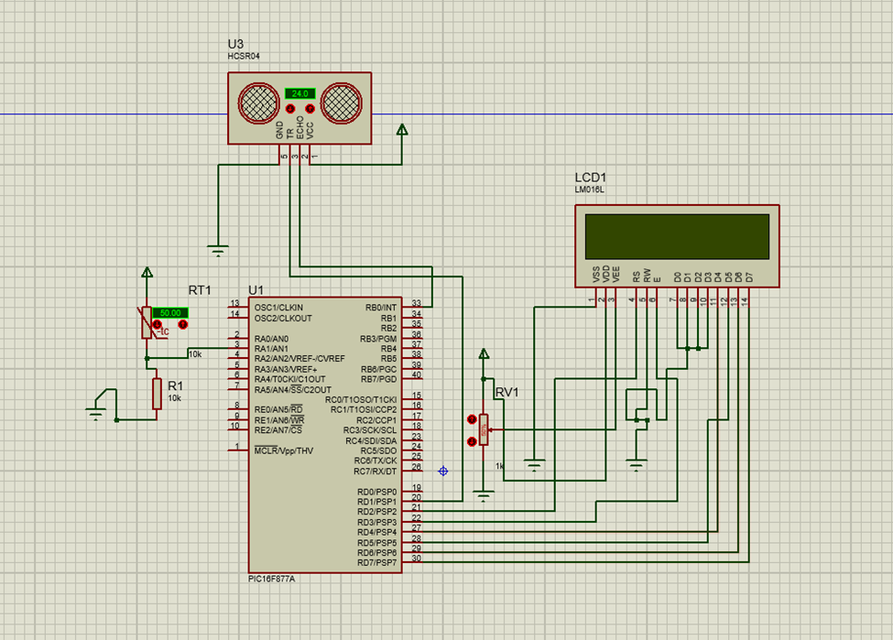
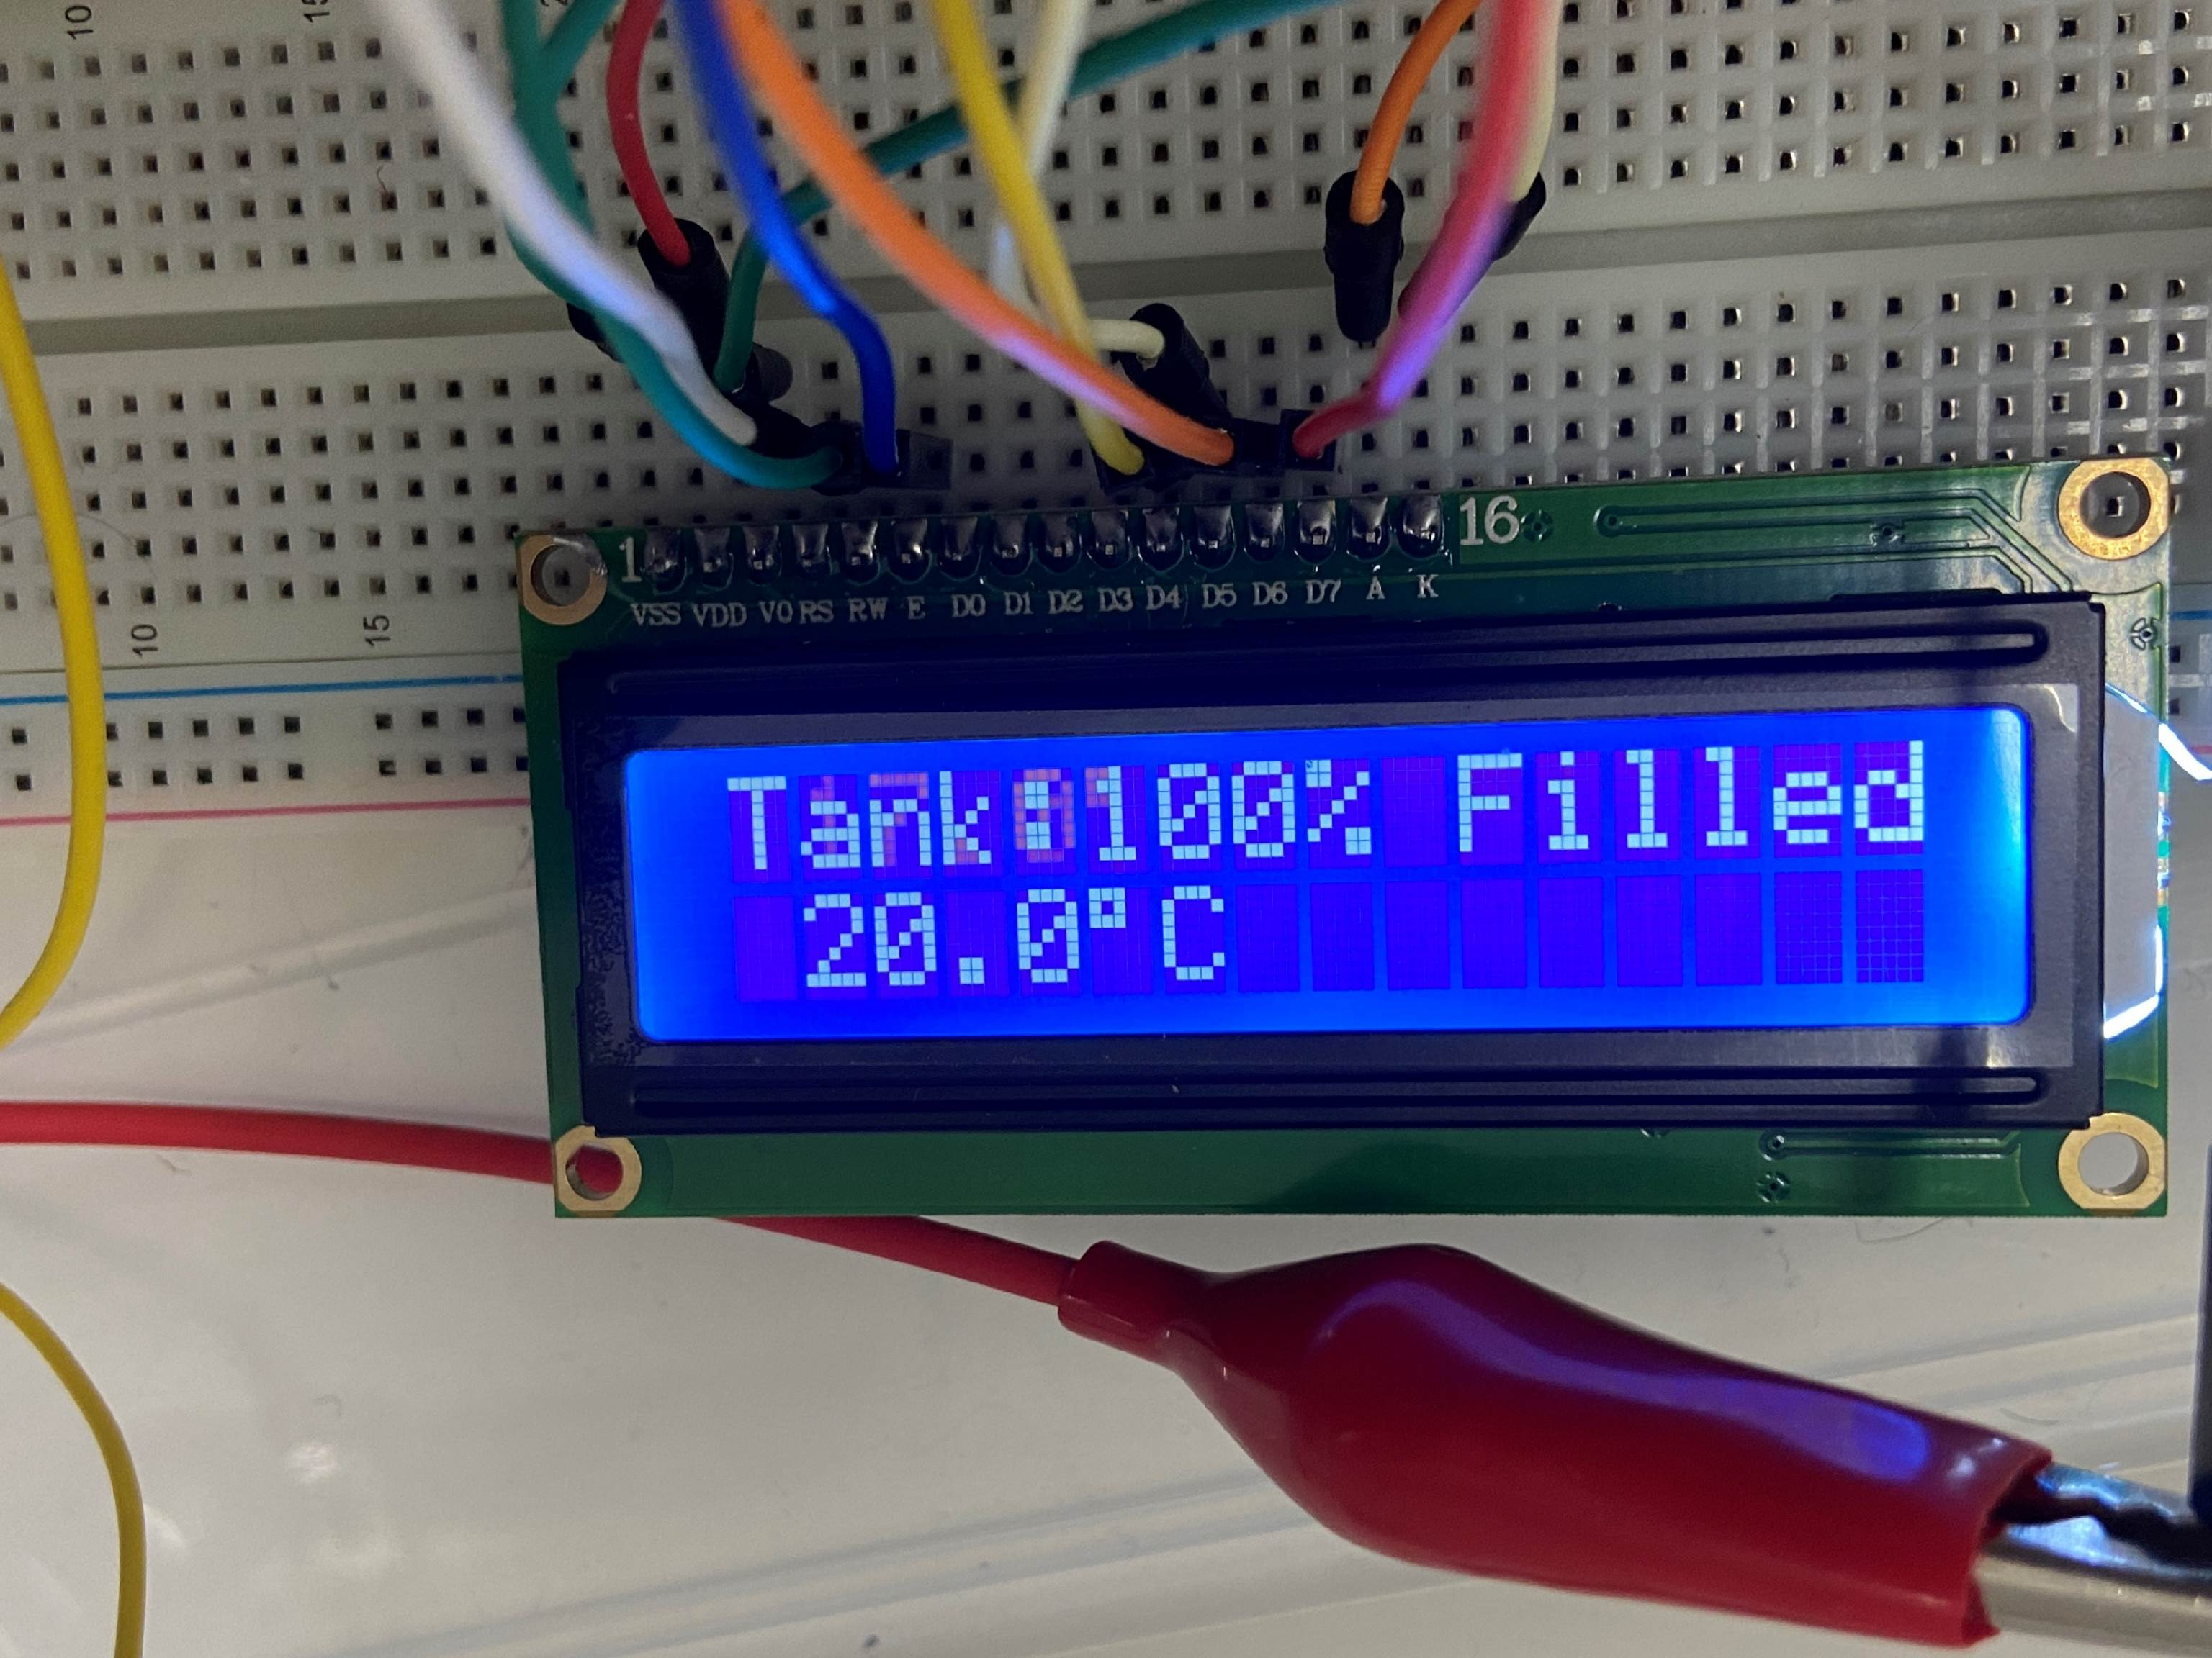
Smart Swimming Pool Monitoring System
Arteen Topolian
Mohamad Halaweh
Mohammad Salhab
Supervisor: Dr. Belal Sababha
Embedded Systems Final Design Project, Fall 2023
King Abdullah II Faculty of Engineering
Princess Sumaya University for Technology
Introduction
The main idea for this project is to create a device that can measure more than one parameter for a liquid medium simultaneously, providing results to aid the user in determining the physical properties of the liquid. This device shows the distance and temperature of the liquid under test and displays it on a 16*2 LCD which helps the user to validate whether the properties of the liquid are within the wanted range.
Mechanical Design
Results
Software Design
A simple flowchart that shows the sequence of actions in our software. The PIC will take the readings from the sensors and display them out on the LCD then the water pump will either be activated or kept off depending on the percentage of water in the pool.
Electrical Design
Figure 1: Software Flowchart
Figure 3: Circuit
Figure 2: Schematic design for the Ultrasonic and Temperature Sensors
Figure 4: Result of ultrasonic and Temperature sensor
Conclusion
The Smart Swimming Pool Monitoring System is a device that aims to provide an easy and convenient way for users to monitor various parameters of a contained body of water, such as water temperature and depth. The system uses a combination of sensors and actuators to collect and display data on an LCD screen, and also includes a water dispensing function that allows users to adjust the water depth as needed. One of the key insights gained from this project is the importance of having accurate and reliable data when it comes to monitoring a liquid medium. By providing real-time measurements of the water temperature and depth, the system can help users ensure that the properties of the liquid are within the desired range, which is crucial for maintaining the overall health and safety of the swimming pool.

